Slide 1
DAE
D = describe the event.
A = analyze the event/object/photo several ways.
E = evaluate your results.

Slide 2
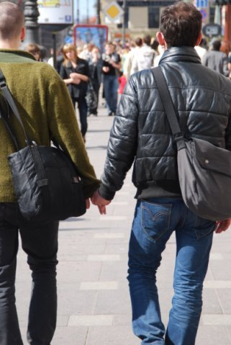
D. A. or E.?
Which one of these answers would be D for Description?
A)Two men holding hands
B) They are lovers
C) They are good friends
Photo from Wikimedia- follow link here

Slide 3
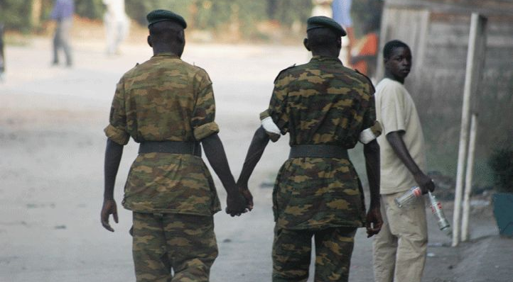
Do men hold hands in your culture?
Photo from Wikimedia- follow link here
In many cultures it is normal for men or women, of any age, who are friends to hold hands without anybody thinking they have a romantic relationship.
Notes:
If you chose (a) then you would be right, it’s a description, just the data. The other two answers analyze what is happening, they provide an interpretation. In some cultures two men walking holding hands would be very normal and in other cultures, people would make interpret the relationship between the two men, even evaluate it, thinking they are bad for holding hands.
An example of evaluation would be for somebody to express prejudice against two men holding hands. “They are dirty” or “they are sinful” is an evaluation.

Slide 4

D. A. or E.?
If someone said, “this is a disgusting habit.”?
A)Description
B) Analysis
C) Evaluation
Photo from Wikimedia- follow link here

Slide 5
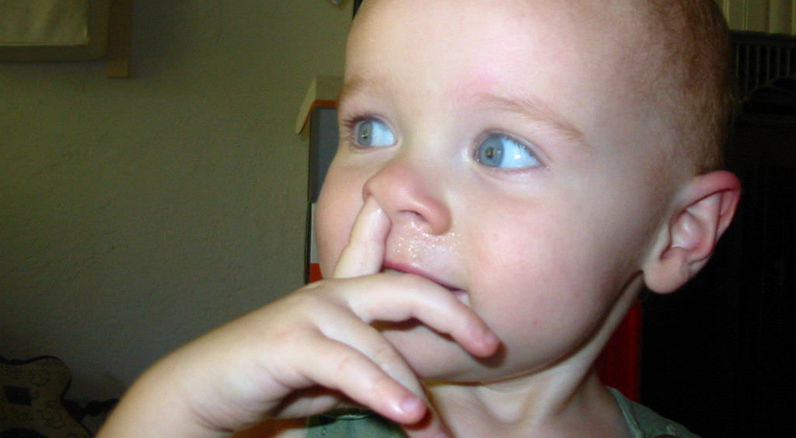
Do you pick your nose?
Photo from Quinn Norton- Flickr- Follow Link here
In many cultures it is not rude to pick your nose in public
Notes:
If you said (a) or (b) you would be wrong, it is (c) Evaluation. It is certainly a very strong personal opinion to say to describe something a person is doing as disgusting. In some cultures, such as in Kenya, picking your nose in public is perfectly normal and certainly not grounds for being called “disgusting.” Do you see how we attach our own judgements and interpretation to things?

Slide 6
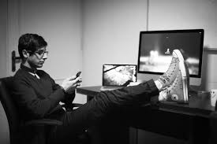
D. A. or E.?
Label which of these statements is Description, Analysis or Evaluation.
A) Lazy guy should be working but is goofing around
B) He’s an app designer
C) This man has his feet on his desk
Photo from Pexels- follow link here
Notes:
Answer- a) Evaluation b) Analysis c) Description

Slide 7
D. A. or E.- Answers
A) Lazy guy should be working but is goofing around- Evaluation
B) He’s an app designer- Analysis
C) This man has his feet on his desk- Description
Photo from Pexels- follow link here
Notes:
Answer- a) Evaluation b) Analysis c) Description

Slide 8
Find photos and examples and share them
Place a link to facebook group or a twitter hashtag

